Slide 1

来华留学生保险
使用指南
International Students Insurance
Instruction Manuel
留学保险项目组
2023.11

Slide 2


1
保险责任 Liability
2
保险理赔 Insurance Reimbursement
3
使用方法 Insurance Instruction
4
投保流程与信息查询 Buy Insurance
& Information Query
5
理赔案例 Reimbursement Example
6
保险提示 Tips

Slide 3
1
保险责任 Liability

Slide 4
保险责任(留学生800元)
RMB 800 scheme for international students(Liability）
 | 800元方案 Plan 800
保障项目 Coverage | 保险金额Insurance Amount(RMB)
身故/意外伤残保险责任 Death/Accidental disability | 100,000
意外医疗保险责任 Accidental medical treatment | 20,000
门诊医疗保险责任 Outpatient and Emergency Medical Injury | 20,000 （日限额600元 免赔额650元,85%赔付） With the daily limit of RMB600,beyond the deductible RMB650, the insured can cover 85% of reimbursement
住院医疗保险责任 Inpatient medical insurance liability | 400,000

Slide 5
2
保险理赔 Insurance Reimbursement

Slide 6


保险报销--须知
4008105119
快递资料
审核核算
流程
汇款至账户
赔付比例
前提：构成保险责任，公立医院普通科室就诊，公费医疗项目。
住院医疗：自费费用不报销，剩余费用100%比例报销
意外医疗门诊: 自费费用不报，剩余费用100%比例报销
疾病门诊: 日限额600元，在600元基础上累计650元以上的部分85%报销。0-650元之间不报销。
身故保险: 构成保险责任，保险金10万元。

Slide 7
Insurance Reimbursement--Terms and conditions
Reimbursement ratio
Notice: Only the medical expense happens in normal department of public hospital while insurance liability constituted can be covered. Self-paid or partly self-paid items and expenses are exceptional.
For hospitalization: Self-paid or partly self-paid items and expenses are exceptional. The rest of expenses will be valued as reasonable expenditure, which can be reimbursed at a percentage of 100%.
For Accidental Medical: Self-paid or partly self-paid items and expenses are exceptional. The rest of expenses will be valued as reasonable expenditure, which can be reimbursed at a percentage of 100%.
800RMB/year: For Outpatient and Emergency disease: The daily limitation is 600 yuan and deductible is 650. We will subtract 650 yuan once per period of insurance. The rest of expense can be reimbursed at a percentage of 85%.
For Accidental Disability: When insurance liability is constituted, the accidental disability insurance money will be paid. The amount of the insurance money will be calculating based on real situation.
For Death: When insurance liability is constituted, 100,000 yuan of death compensation will be paid. (The sum of accidental disability and death insurance money shall not exceed RMB 100,000)

Slide 8
保险报销—800方案为例
疾病门诊：被保险人因疾病在门诊进行治疗所发生的合理且必要的医疗费用，在一个保险期间内，就诊日费用限额为600元（即：若当日医疗费用超日限额的只能按600元计算，当日医疗费用未超600元限额的按实际发生金额计算），在日限额的基础上累计达到650元（免赔额）以上的部分保险人按照85%的比例予以赔付。
即：如因发烧、突然腹痛、晕倒、身体某处炎症等等在门诊或急诊进行治疗的；
报销公式：(每天在日限额以内的费用相加-650元)*85%=可报销费用（合理费用合计不含当地社会基本医疗保险规定的自费及部分自费费用）。
释：
650元为免赔额（一个保险期间内累计扣一次650元），免赔额以下部分不予赔付。

Slide 9
Insurance Reimbursement—800RMB/year for example
Outpatient and Emergency Medical Insurance:
The reasonable and necessary expenses incurred by the Insured for receiving outpatient or emergency medical treatment because of illness, within each insurance time, the daily limit for outpatient is RMB600，(that said, for the medical expense of the day exceeding RMB 600 shall be calculated as RMB600, for the medical expense of the day not exceeding RMB600 shall be calculated by the actual amount). For the medical expenses exceeding the starting line of RMB650, the remaining amount after deducting RMB650 will be reimbursed at a percentage of 85%.
That is: being treated in the outpatient or emergency for fever, sudden abdominal pain, faint, and inflammation etc.
Reimbursement equation: (the expense of each day within the daily limit add up-650) * 85%=reimbursable amount (the total amount of reasonable expenditures shall exclude the self-paid or partly self-paid items and expenses stipulated by the local regulations of the social basic medical insurance)
The deductible is RMB 650 (accumulative for one time during one valid insurance period). Below the deductible, there is no claim.

Slide 10
保险报销--理赔须知 Insurance Reimbursement--Terms and conditions
例如，你交的是800元或400元的保费，在保险期间内因病在当地的公立医院就诊，2019年2月1日花费900元，5月3日花费400元，7月15日花费700元（就诊费用均为合理费用）。
理赔计算公式：{（600元+400元+600元）-650元}*85%=807.50元
If you have paid an insurance fee at RMB 800 or RMB 400, then you have paid RMB 900 on February 1st, 2019, paid RMB 400 on May 3rd, and RMB 700 on July 15th (all the fees for clinical service are rational) due to being treated in a local public hospital within the insurance period.
The formula for claim settlement: {（600 +400 +600）-650}*85%=807.50 (Unit: RMB Yuan)

Slide 11

Insurance Reimbursement – Accidental Medical
Scan the QR
You will be guided how to apply the accidental claim and notice about treatment

Slide 12

Insurance Reimbursement – Outpatient and Emergency
Scan the QR
You will be guided how to apply the disease claim and notice about treatment

Slide 13
3
保险使用方法 Insurance instruction

Slide 14
保险使用方法 Insurance instruction
门诊治疗（学生先支付，后期材料通过自助端上传或快递至服务公司申请理赔）
从不舒服开始
致电4008105119
服务医生询诊给出治疗建议
病情确实需住院治疗（符合住院条件，可申请住院垫付）
Outpatient treatment: Pre-payment by the students in first. Then student can apply claim online or send the documents by post.
diagnosis and treatment recommendations by the doctor
dial 4008105119
When you feel uncomfortable
In-patient: If students really in need of hospitalization (If qualified , you can apply for payment in advanced.)

Slide 15

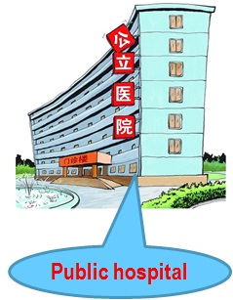
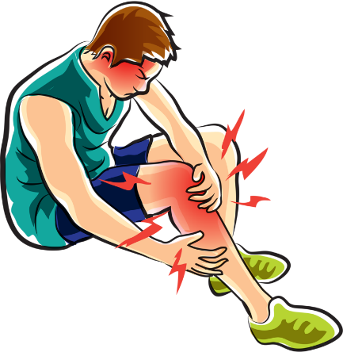

保险使用方法 Insurance instruction
一定记得写病历
而且是每次
Must have medical record every time.
发生意外
留收据 invoice
Notes:
举个例子：如果发生了意外（摔伤、扭伤、碰伤等），一定到正规的公立医院治疗，公费医疗、社保标准的费用，100%赔付，申请理赔时，病历、交费收据原件是必须提供的。
注意：意外责任自保险生效日期起即保。

Slide 16
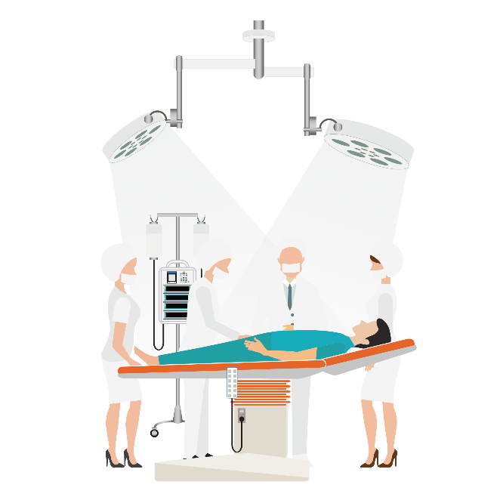

保险使用方法 Insurance instruction
需要住院
Need inpatient
4008105119
If you want to apply inpatient in advanced, please call us before in hospital. Otherwise you should pay by yourself first.
如果看门诊后，医生说需要住院，一定要在住院前拨打电话，如果符合条件，可以得到医疗费的垫付,学生就可以安心治疗了。
Notes:
如果看门诊后，医生说需要住院，一定先打电话，如果是网络医院，可以得到医疗费的垫付,学生就可以安心治疗了。
注意：因疾病门诊及疾病住院这项责任是保险生效日30天（等待期、观察期）之后发生的，保险公司才负责理赔。

Slide 17
保险使用方法 Insurance instruction
理赔申请资料
所需 材料 申请 项目 | 护照复印件及签证页复印件 | 医院发票原件 | 病历复印件（每次就诊病历日期与发票日期相对应） | 费用明细 | 意外事故证明 | 出院小结或住院病历复印件 | 银行存折复印件或银行卡客户信息表 | 理赔申请书
意外门诊 | 需要 | 需要 | 需要 |  | 需要 |  | 需要 | 需要
疾病门诊 | 需要 | 需要 | 需要 |  |  |  | 需要 | 需要
住院（因意外） | 需要 | 需要 |  | 需要 | 需要 | 需要 | 需要 | 需要
住院（因疾病） | 需要 | 需要 |  | 需要 |  | 需要 | 需要 | 需要
注意事项：
1、就诊前务必拨打电话4008105119进行寻诊；
2、意外事故须提供意外事故证明及相关部门的定性材料（如：交通事故须出具交通部门的交通事故责任认定书等）；
3、银行账户信息必需包括账号、帐户名和开户行信息。
4、治疗结束后，请尽快提交理赔材料。
Notes:
这是申请赔付时需要资料的简表，像护照、签证的复印件，医院发票原件都是必须的，一定要提供正确的银行卡信息（帐户银行支付、账号、开户名），理赔款会直接汇到银行卡里

Slide 18
保险使用方法 Insurance instruction
Firstly, you should prepare the following documents as required. Then, please send the documents to us.
Documents for Claims Insurance Liabilities | Copy of passport and visa page | Original invoices | Medical record(the date in every medical record should be corresponding to the date in every receipt) | Original of detailed expenditure sheet | Course and certificate of accident | Copy of hospital discharge summary or medical record of hospitalization | Copy of passbook or information sheet of bank card customer | Claim application form
Outpatient(because of accident) | Needful | Needful | Needful |  | Needful |  | Needful | Needful
Outpatient(because of disease) | Needful | Needful | Needful |  |  |  | Needful | Needful
Hospitalization(because of accident) | Needful | Needful |  | Needful | Needful | Needful | Needful | Needful
Hospitalization(because of disease) | Needful | Needful |  | Needful |  | Needful | Needful | Needful
Please pay attention to the following matters:
1. Before seeing a doctor, please call 4008105119 for medical reporting.
2. Certificate of accident, in case of a traffic accident, please submit a liability conformation of traffic accident issued by the traffic unit. And if other accidents happen, please also submit relative certification materials.
3.The information about bank account has to include account number, account name and name of the deposit bank.
4.When you finish treatment , please send to us claim documents as soon as possible.
Notes:
这是申请赔付时需要资料的简表，像护照、签证的复印件，医院发票原件都是必须的，一定要提供正确的银行卡信息（帐户银行支付、账号、开户名），理赔款会直接汇到银行卡里

Slide 19
4
投保流程及投保结果查询 Buy insurance

Slide 20
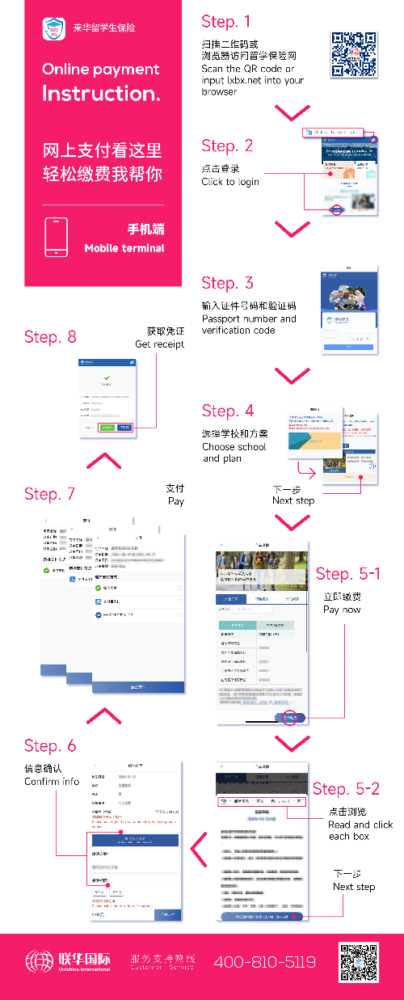
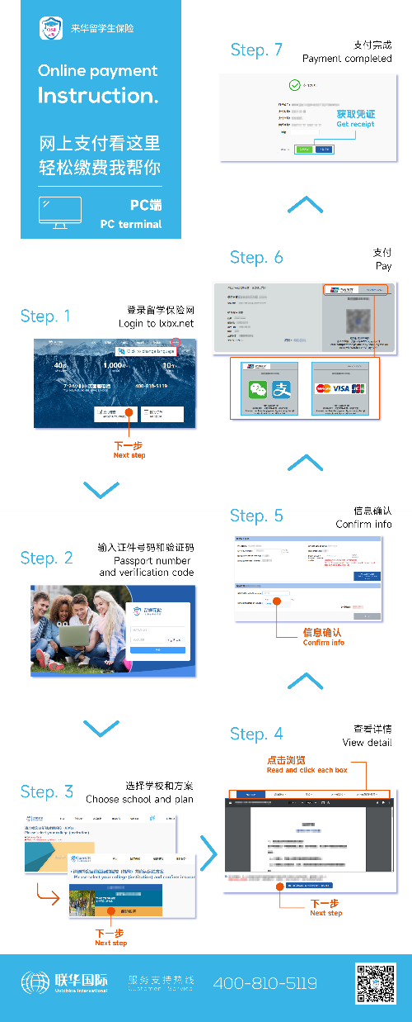
投保流程
留学生可以参照右侧的网支流程图进行网上支付。
两张图分别对应手机端支付路径和电脑端支付路径。

Slide 21

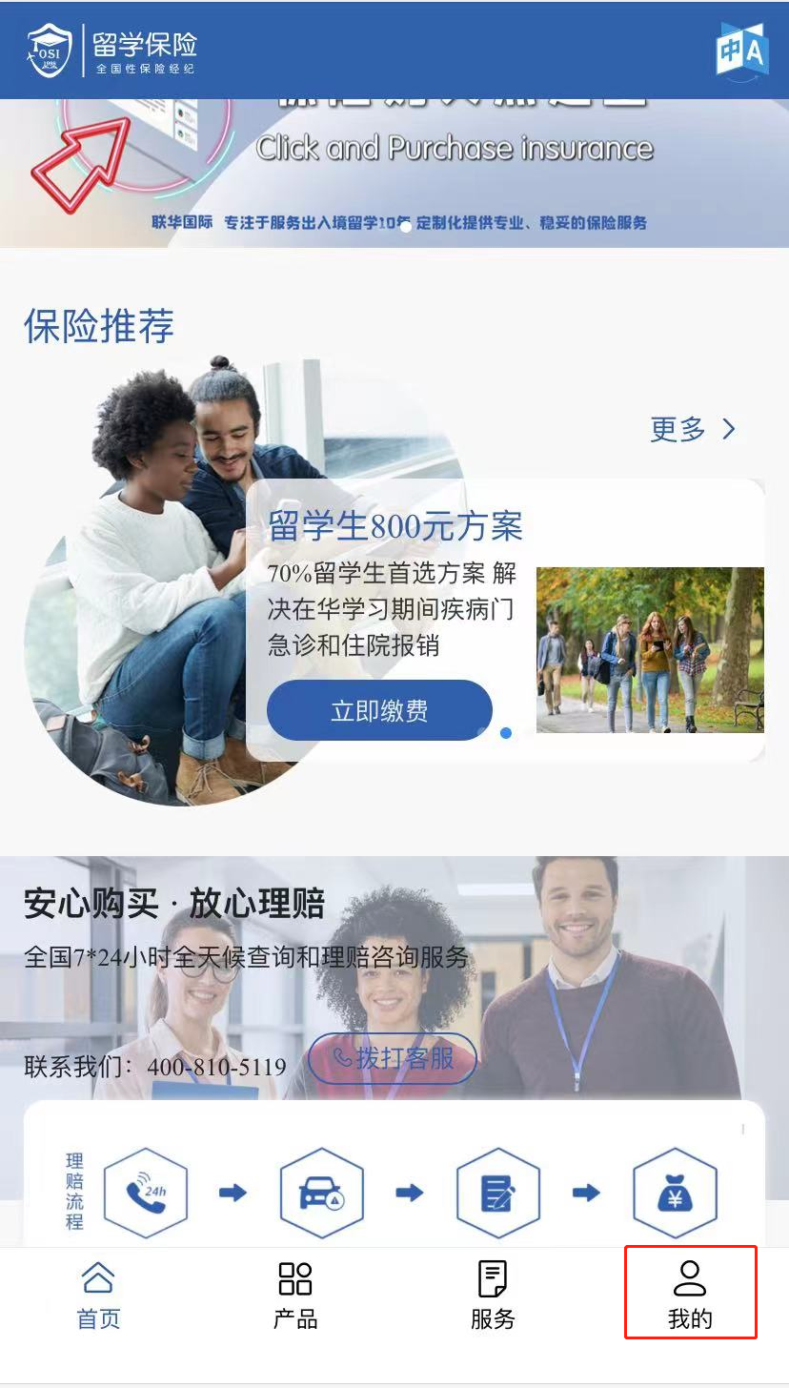
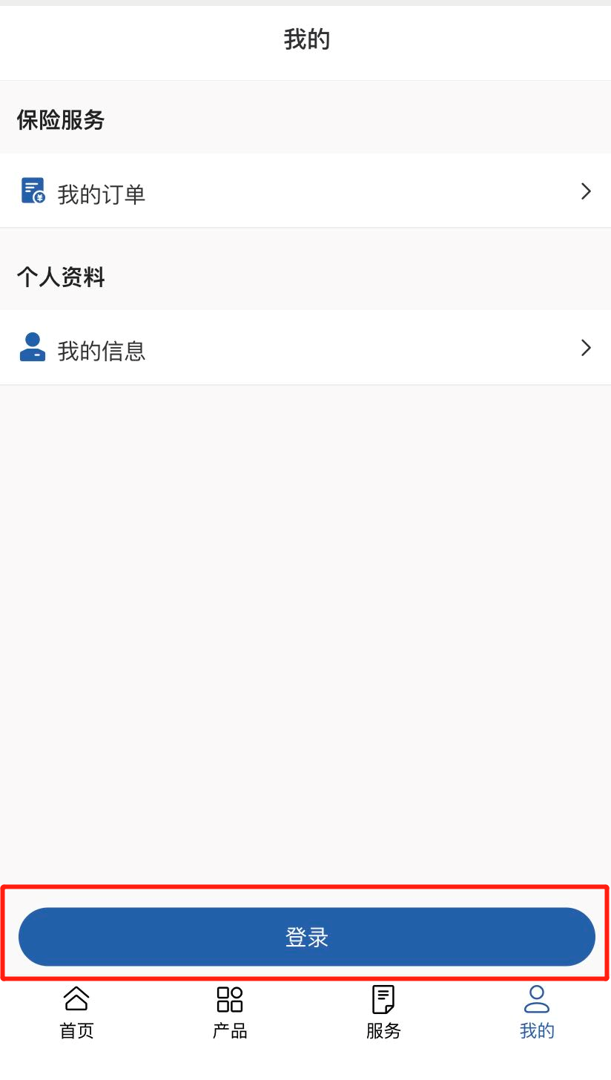
信息查询_手机 Query via Cell Phones
手机查询信息Query via Cell Phones
1. 扫描二维码
Scan the QR Code
2. 点击“登录
” Click “Log in”
2. 点击“我的”
Click “My Index”
Notes:
另一个保险的查询方式是手机查询,用微信中的扫一扫,扫二维码，录入服务卡号或护照号，可以查到当前保险情况，你提交的理赔的进展信息

Slide 22

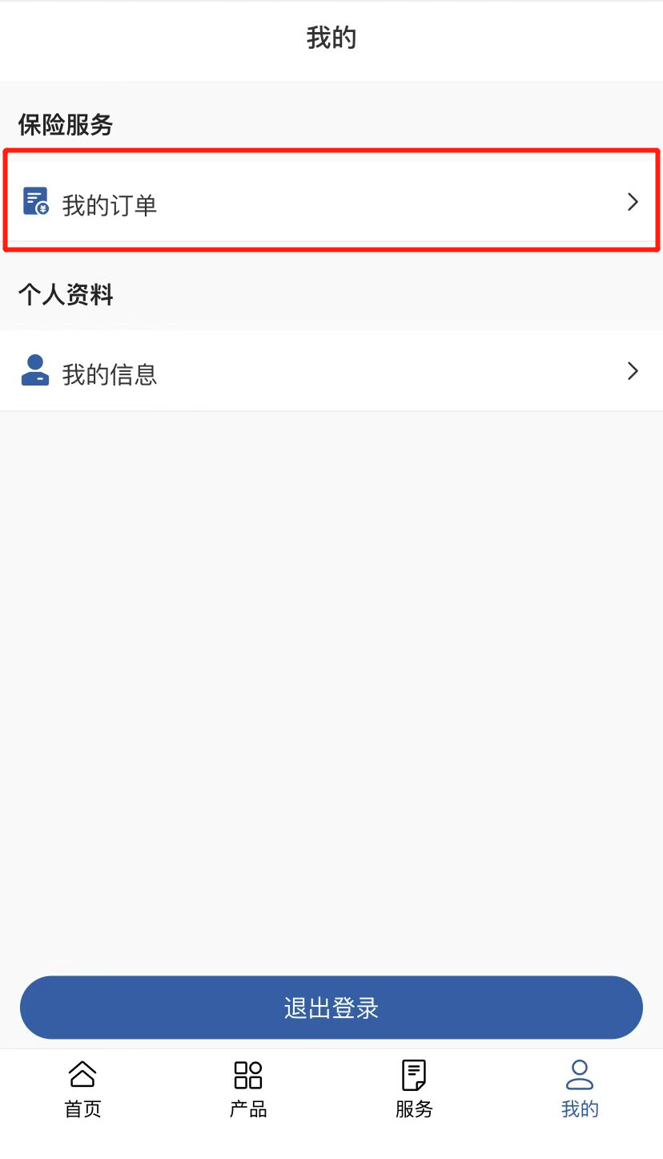
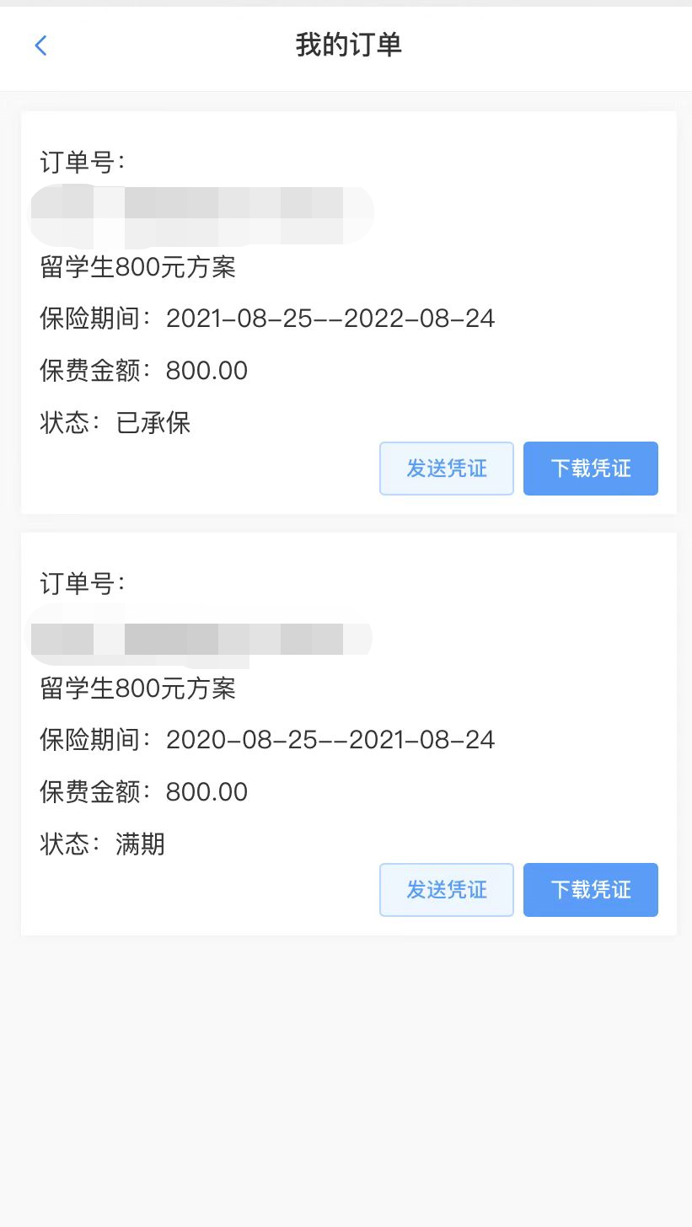
信息查询_手机 Query via Cell Phones
5. 填写邮箱点击发送
或点击【下载电子收据】
Email or Download electronic receipt
4. 点击我的订单
Click “My orders”
3. 输入护照号和验证码
Passport number and verification code
Notes:
手机里还可以查到七种文字的保险责任、理赔须知，以及理赔资料快递的地址。

Slide 23
5
理赔案例
Reimbursement Example

Slide 24

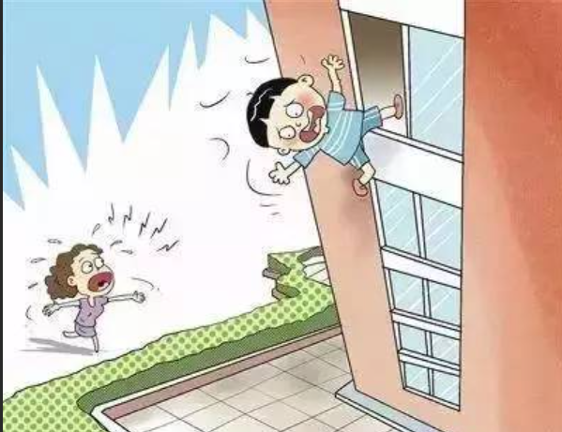
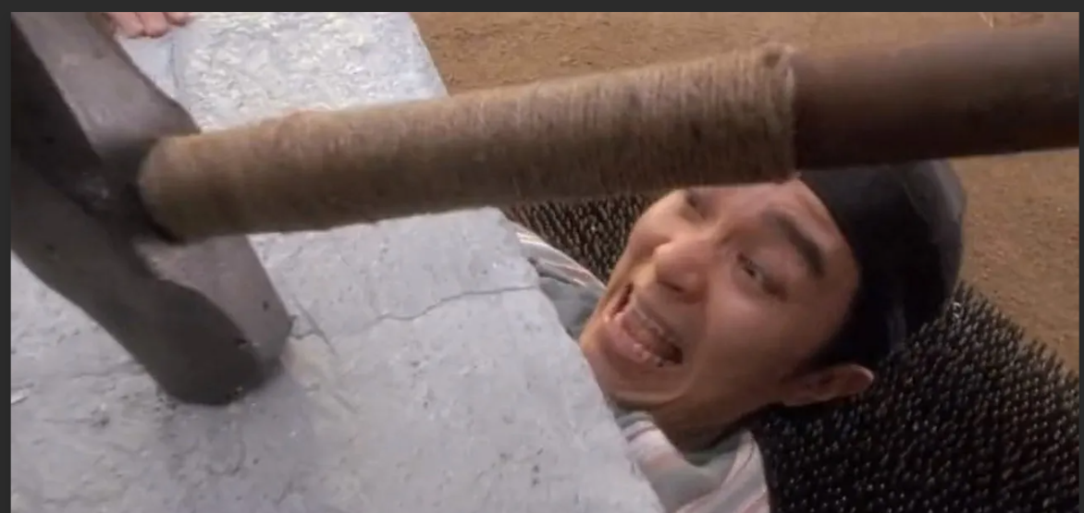
The real case…
Drinking shampoo X
Climbing the window X
Break a rock in the chest X
Chinese kung fu

Slide 25
6
保险提示 Tips

Slide 26
免责提示(Liability Exemption Tips)
外宾病区
ward area for foreigners
酒后驾驶、无合法有效驾驶证驾驶，或驾驶无有效行驶证的机动车
Driving under the influence, driving without a legal and valid driving license or driving a motor vehicle without a valid driving license on the part of the Insured;
特诊特需病房及病区
ward area for special treatment and needs
怀孕、流产、分娩、不孕不育症治疗、人工受精、产前产后检查；节育、堕胎，及以上原因引起的并发症
Pregnancy, miscarriage or delivery on the part of the Insured, infertility treatment, artificial insemination, prenatal and postnatal check, birth control, abortion and complications caused by above-mentioned causes;
高干病房
ward for high-ranking officials
Notes:
保险提示：不能使用保险的医院，及一些状况看病后不赔的。

Slide 27
免责提示(Liability Exemption Tips)
免赔额650元以下部分不予赔付
Deductible: RMB 650 , Below the deductible, there is no claim.
患先天性疾病、遗传性疾病、既往症（投保前已患疾病或已存在的症状，保险期间非连续的）
Congenital diseases, hereditary diseases, existing disease (disease or symptoms that already exist prior to the date of insurance);
自费和部分自费项目均不能报销
the self-paid or partly self-paid items expenses cannot be reimbursed.
矫形、矫正、整容或康复性治疗
Expenses of orthopedics, diathesis, face-lift or rehabilitation therapy received by the Insurer
Notes:
不赔的提示。

Slide 28
保险备注提示(other insurance tips)
保险细则以
《来华人员综合保险保障计划简介》为准，或参阅www.lxbx.net中的投保指南及理赔指南
The policy terms and conditions shall be in accordance with Comprehensive Insurance & Protection Scheme for Foreigners Staying in China. You can also refer to the Insurance Guide and Claim Guide on www.lxbx.net.

Slide 29

祝大家在中国的学习生活
开心 快乐 健康

